Slide 1
Gender-Based Differences in Job Descriptions
Team 5 – Liron Cohen, Yuval Mor, Ofer Tlusty

Slide 2
Research problem
Gender-based differences in job descriptions in the software engineering industry
Women may be discouraged from applying for jobs in male-dominated or highly competitive environments, aspects that can be reflected in job descriptions.
We aim to examine job descriptions and explore the impact of job characteristics on women's job application decisions.

Slide 3


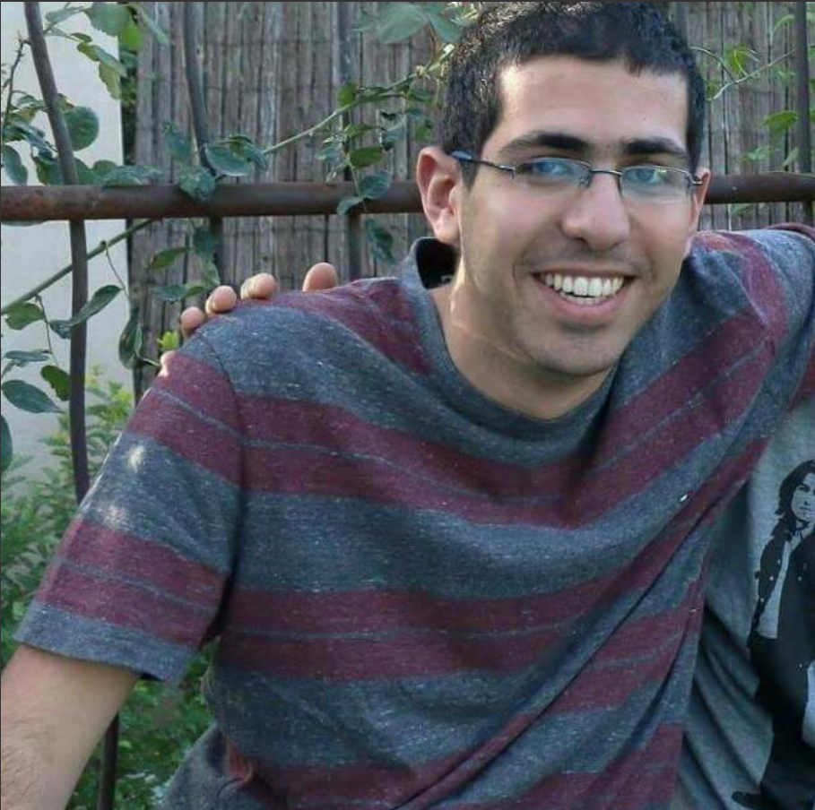
About us
We are all connected to the gender-biased problem in the high-tech industry.
We strive for gender-equality and we want to help the recruitment teams to be as much inclusive as possible when they are writing job descriptions.
We also used labor studies team as domain experts.
Notes:
We decided to research this topic as we are all connected to the gender-biased problem in the high-tech industry. We want to help the effort of gender-equality and help the recruitment teams to encourage women to apply and be as much inclusive as possible when they are writing job descriptions.
We used labor studies team as domain experts.

Slide 4
Iteration 2 Summary
~75 working hours total

Slide 5
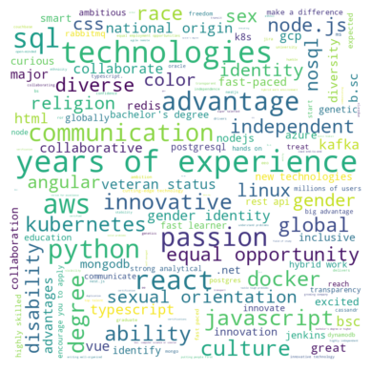
LinkedIn job description analysis
Analyzed our LinkedIn job description database – extracted phrases that can discourage women from applying to the job
Looked for phrases from our experts (labor studies team) and used an NLP model to enrich the list
Analyzed statistically the phrases per category (work environment, skills etc)
results per description and per phrase:

Slide 6
More data sources collection
We found two job description datasets from Kaggle
We also found one small dataset about Glassdoor job reviews from Kaggle that we may use

Slide 7
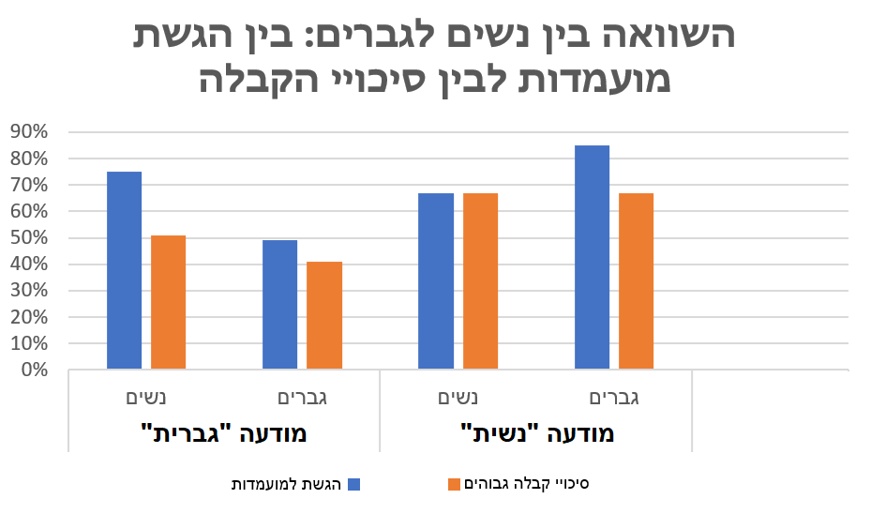
Labor studies survey results
We conducted a survey in collaboration with labor studies team with interesting results
Notes:
מיטל: הסבר לפער 1. שינוי מגמה (בסקירה הספרותית המחקרים מלפני 10 שנים, ראינו שרב העונות לסקר היו בטווח של 6-8 שנים ניסיון מה שמעיד על דור הZ/Y
2 החסרנו כטנולוגיות מראש לטובת גנריות של תיאורי המשרה וראינו שרב הגברים אמרו שלא הגישו בגלל חוסר בטכנולוגיות לעומת נשים שחלקן הגישו דווקא בגלל : חוסר דרישות טכנולוגי

Slide 8
Iteration 3 planning
We will continue cleaning the data sources from Kaggle and improve our current NLP statistical model to enrich the biased phrases list
We will ask the expert (GPT or BARD) for 1-5 grading for our Israeli LinkedIn set, as our testbench
We will build and train an ML model to grade job descriptions on how gender-inclusive (or gender-biased) it is, based on our expert opinion and biased phrases list
~60-70 working hours

Slide 9
Thank you!

